Slide 1

This Photo by Unknown author is licensed under CC BY-SA.

Slide 2

Pokémon Game Analysis
Project 3 - Team 12:
Andreza dos Santos
Prabha Shankar
Hinna Ahmad
Anjali Sagar
Instructor: Abdo

Slide 3

Objective of the project
In 2016 Niantic in collaboration with Nintendo has launched a mobile game called Pokémon Go. The objective of this project is analyze some particularise of this game which has been downloaded over 1 billion times and named “Best Mobile Game” by the Game Developers Choice Awards and “Best App of the Year” by TechCrunch.
Major Questions
- How to help first time players to know more about Pokémon character?
- How to help players choose the best Pokémon for a battle?
- How many types of Pokémon exist? Is there difference between Generations?
- Is the weather reflecting the type of Pokémon that shows up?
- Which areas each Pokémon most likely would appear?
This Photo by Unknown author is licensed under CC BY-SA.

Slide 4

Pokemon cards
Let's take a look at some valuable and rare pokemon cards by their ID and types.
Api : https://pokeapi.co/api/v2/pokemon/

Slide 5
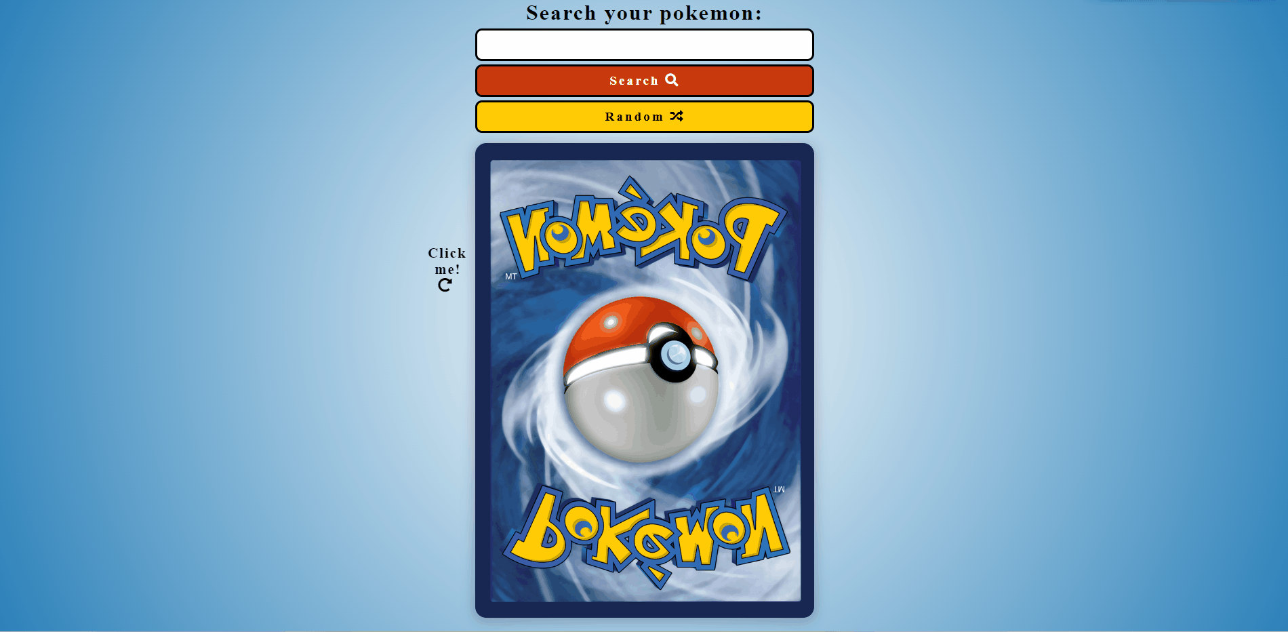

Slide 6
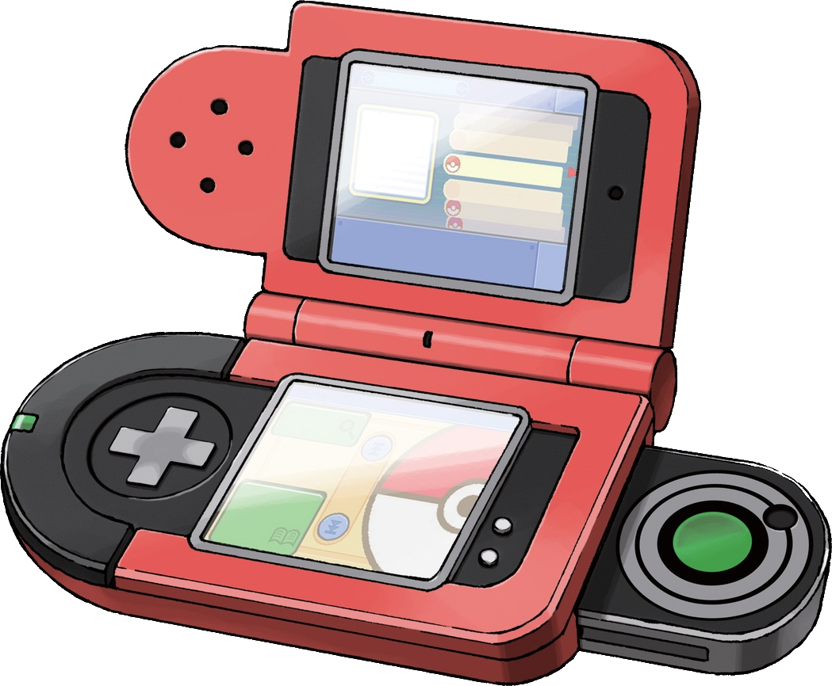
PokeDex
Let's compare the HP, Attack, Defense, Speed of each Pokémon and be prepared for the battle.
Notes:
API https://pokeapi.co/
@import https://fonts.googleapis.com/css?family=Muli&display=swap
@import https://fonts.googleapis.com/css?family=Lato:300,400&display=swap
This Photo by Unknown author is licensed under CC BY-SA.

Slide 7


Slide 8

Generations
1996–1998: First generation
1999–2001: Second generation
2002–2005: Third generation
2006–2009: Fourth generation
2010–2012: Fifth generation
2013–2015: Sixth generation
2016–2018: Seventh generation
2019–2021: Eighth generation
2022–present: Ninth generation
Notes:
Our data is up to 6th Generation
@import https://unpkg.com/open-props/open-props.min.css
@import https://unpkg.com/open-props/normalize.min.css

Slide 9
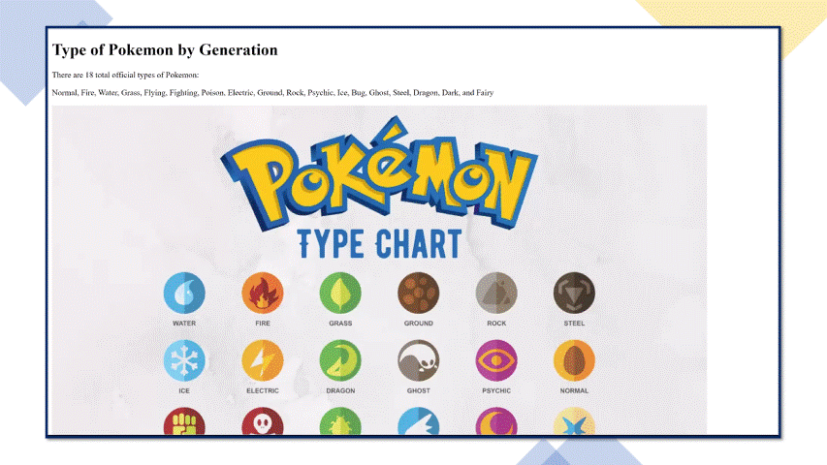

Slide 10
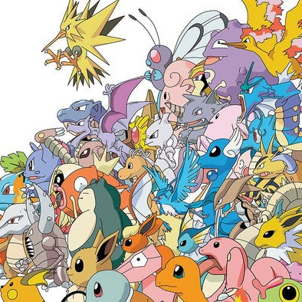
Pokémon and Weather
Pokémon GO responds to the real-world weather conditions around you. Weather changes cause certain Pokémon types to appear more frequently
For Example :
How does weather Affect Pokémon spawn?
If it's raining in town, it will rain in-game. Weather will increase certain Pokémon spawns, for example, Water-type Pokémon will appear more frequently during rain.

Slide 11
Weather and Pokémon
According to the Analysis
Most Pokémon appear in clear weather and the number is 1,022,892.
The numbers are close when it comes to Partly Cloudy and Mostly Cloudy this is the second weather type they appear in Partly(279,834) Mostly((290,094).
Next weather is overcast where (86,514) appear in this weather.
Pokémon do not like fog so that when they appear the less 7,746 times.
Let's look at the graph now to visualize it.
Visual :chart.js

Slide 12
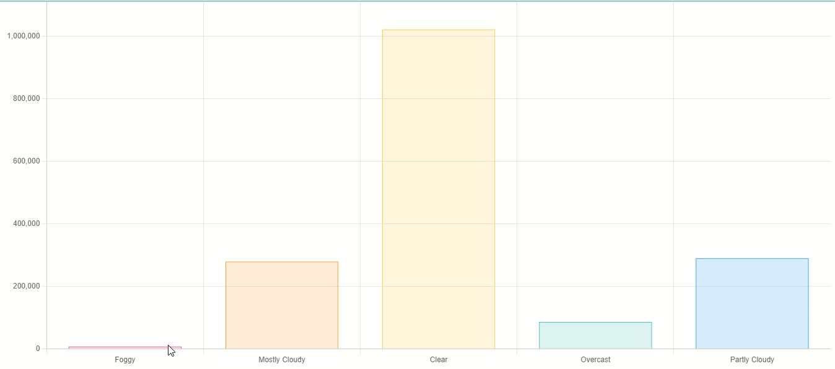

Slide 13

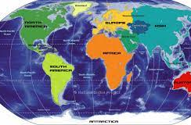
POKEMON AND CONTINENTS There are six continents in the Pokémon game itself. The continent they have appeared in most is America (903,270). Next up is Europe where they appeared 732,870 times. Then we have three continent which are close in number. Asia (93,702) Pacific (11,952) Australia(20,478) The continent they appeared in the least is America/Indiana (6,294) Let's look at the graph now to visualize it. Visual :chart.js

Slide 14
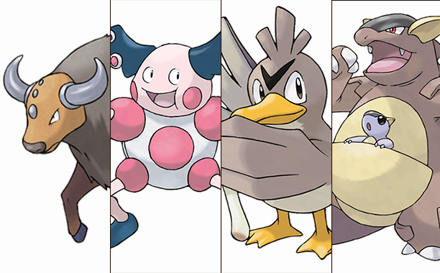
Specific Continents:
It turns out catching ’em all may take quite a bit more than just a few strolls around your neighborhood. Fans of the hit mobile game Pokémon Go may have stumbled upon information that four of the game’s rare creatures can only be found in specific continents.
According to location info on the popular franchise forum Serebii, Tauros can only be caught in North America, Mr. Mime can only be caught in Europe, Farfetch’d is only available in Asia, and Kangaskhan is exclusive to Australia.

Slide 15
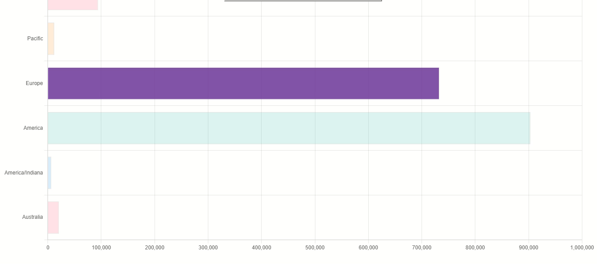

Slide 16
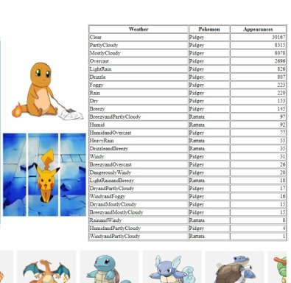

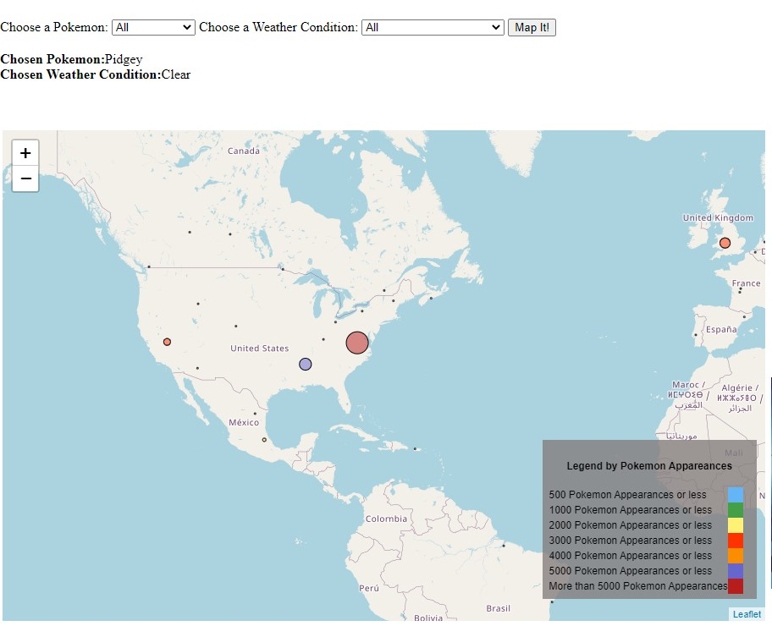
Mapping Pokemon
Niantic tweets
The Pokémon that are born from eggs have been switched up.
Pidgey, Rattata, and Zubat were previously more commonly found but eventually got tweaked .. Why??

Slide 17
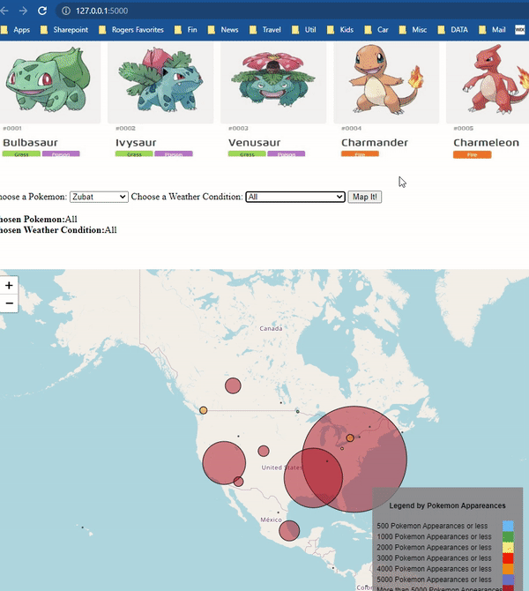
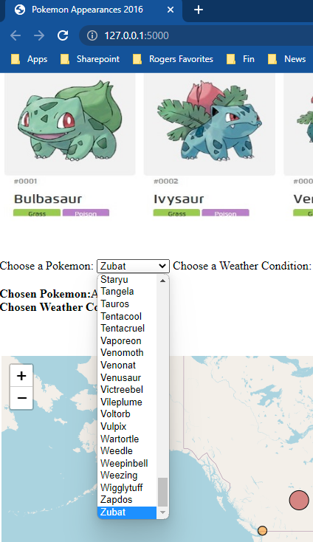
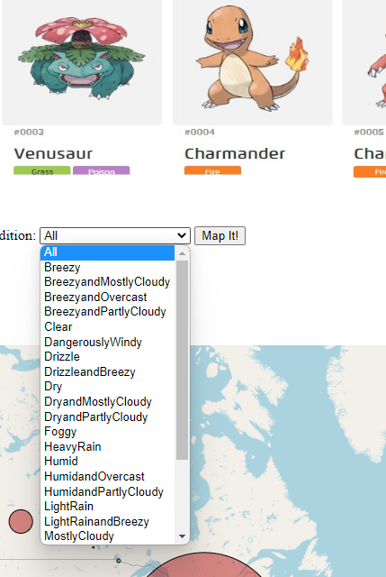
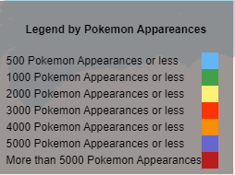
Mapping Pokemon
The game was first launched on July 6, 2016.
Game Freak, the company that first developed Pokémon, didn’t always make video games.
When it began, in the 1980s, it was actually a video game magazine.
In the first week alone, Pokémon Go sent up Nintendo’s stock through the roof by adding $7.5 billion to the company’s market value
Pokemon Go sold millions and in a month $200 million in revenue

Slide 18
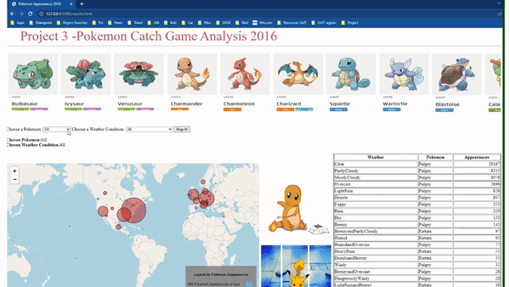
Mapping Pokemon
Take away:
Augmented reality
A combination of digital and physical worlds, interactions made in real time, and accurate 3D identification of virtual and real objects.
Future....
And…..the future

Slide 19


Thank you!! Any Questions??
Notes:
Done! ;)

